Slide 1



Electric-Vehicle-Range-prediction
Arjun college of technology
Student names:
A.Kishore Reddy
P.Jeevan Reddy
G.Samba Siva Reddy
C.Yaswanth
V.Siva Bindhu

Slide 2
Problem Statement :
Electric vehicles (EVs) are becoming increasingly popular, but range anxiety—concerns about running out of charge before reaching a charging station—remains a major barrier to adoption. Accurately predicting an EV's range is challenging due to various factors such as battery capacity, driving behavior, terrain, weather conditions, and energy consumption patterns. This case study aims to develop a reliable EV range prediction model that helps users make informed decisions and optimize battery usage.
Key Objectives:
Identify Key Factors Affecting EV Range – Analyze how battery health, road conditions, temperature, and driving habits impact range.
Develop a Predictive Model – Use machine learning or statistical techniques to estimate EV range based on real-time and historical data.
Enhance User Experience – Provide accurate range estimates to reduce range anxiety and improve trip planning.
Optimize Energy Efficiency – Suggest driving and charging strategies to maximize range and battery life.
Validate and Improve the Model – Test the prediction accuracy using real-world driving data and refine the approach for better reliability.

Slide 3
Solution :
Solution for Electric Vehicle Range Prediction
To address the challenges of accurately predicting the range of electric vehicles (EVs), we propose a data-driven approach that integrates advanced machine learning models, real-time data collection, and optimization techniques.
Proposed Solution:
1. Data Collection and Preprocessing
To build an accurate EV range prediction model, we need to gather and preprocess various data sources, including:
Vehicle Data: Battery charge level, energy consumption rate, vehicle weight, regenerative braking efficiency.
Environmental Data: Temperature, humidity, wind speed, road type (highway, city, uphill, downhill).
Driver Behavior: Speed, acceleration, braking patterns, use of air conditioning/heating.
Historical Data: Previous trip distances, battery degradation patterns, charging frequency.
Data preprocessing steps include handling missing values, normalizing data, and feature engineering to improve model performance.

Slide 4
Dataset Overview :
Dataset Description:
This dataset is designed to assist in predicting the range of electric vehicles based on various factors including battery capacity, driving behavior, environmental conditions, and vehicle specifications.
Key Features:
1.Battery Specifications:
Battery Capacity (kWh): The total energy capacity of the EV's battery, influencing how far the car can travel on a single charge.
State of Charge (SOC): The current charge level of the battery, given as a percentage.
Battery Health (SOH): The state of health of the battery, which degrades over time and affects driving range.
2.Vehicle Specifications:
Vehicle Weight (kg): Heavier vehicles tend to consume more energy.
Motor Efficiency: The efficiency of the motor impacts how much energy is consumed.
Tire Type & Pressure: Tire characteristics can affect rolling resistance and thus energy usageDriving 3.Conditions:
Driving Speed (km/h): Higher speeds often lead to more energy consumption.
Acceleration Patterns: The rate at which the vehicle accelerates, which influences energy use.
Driving Mode (eco, normal, sport): Different driving modes that adjust vehicle parameters to optimize efficiency.
.

Slide 5
Methodology :
Approach:1. Data Collection and Preprocessing
Data Collection: The first step is to gather data from various sources, including EV-specific datasets (such as the ones discussed earlier, e.g., battery capacity, driving conditions, weather, etc.), EV sensors, and real-world driving logs.
Data Cleaning: Remove any missing, inconsistent, or erroneous entries from the dataset.
Algorithms Used:
1.Linear Regression:
Why: Linear regression can serve as a baseline model to understand the relationship between input variables (e.g., battery health, driving speed) and the target variable (range). It’s simple and interpretable.
How: The model assumes a linear relationship between the features and the target, making it easy to interpret the influence of each factor on range prediction.
2.Random Forest Regression:
Why: Random Forest is a robust ensemble learning technique that works well for capturing non-linear relationships between features. It is especially useful for handling large datasets with many variables.
How: It builds multiple decision trees and averages their predictions. It is particularly effective in handling diverse factors like driving behavior, environmental conditions, and battery health.

Slide 6
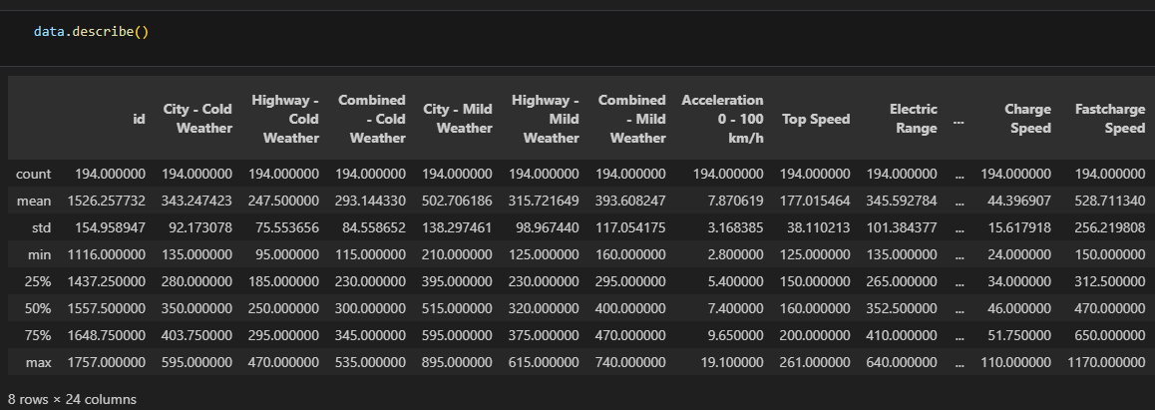
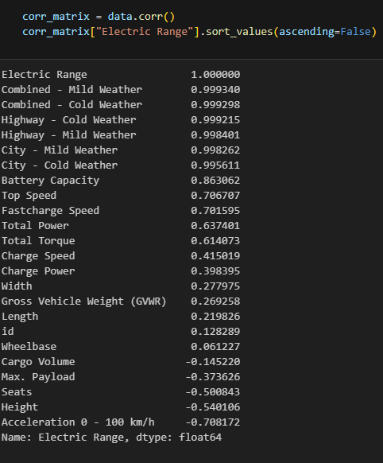
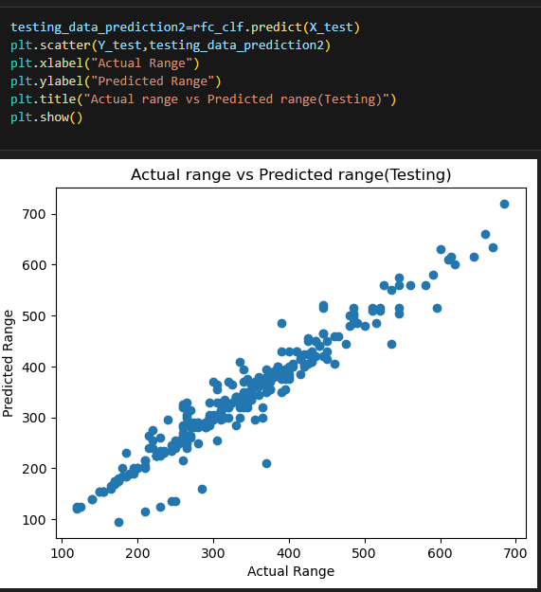
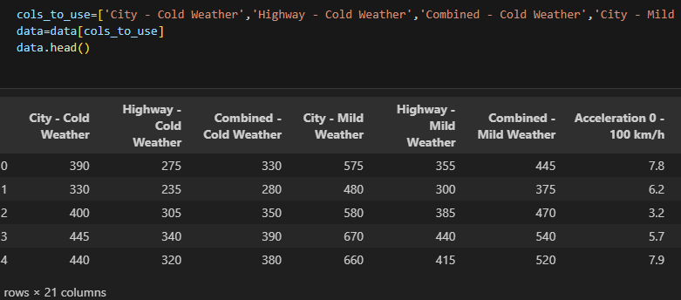
Results :

Slide 7

Conclusion :
Summary:The electric vehicle (EV) range prediction problem involves predicting how far an EV can travel on a single charge under varying driving conditions, battery health, and environmental factors. The case study demonstrated a comprehensive approach to solving this problem using machine learning techniques.
Future Work:
1.Improved Battery Health Modeling:
As battery health significantly affects EV range, future research can focus on better modeling battery degradation over time. This could include more detailed data on individual battery cells, temperature fluctuations, and charging patterns to more accurately predict long-term battery performance and its impact on range.
2.Incorporating More Real-Time Data:
Integrating real-time data from the vehicle, such as live weather updates, traffic conditions, and GPS-based route planning, can provide even more accurate predictions. By combining real-time environmental data with historical data, EV range predictions could become more dynamic and context-aware.
3.Vehicle-to-Vehicle Data Sharing:
Future systems could enable vehicle-to-vehicle communication, where data from one EV (e.g., battery usage, terrain conditions) is shared with other EVs in real time. This data sharing can improve predictions, especially in unfamiliar or complex driving environments.

Slide 8
References :
1.https://www.sciencedirect.com/science/article/pii/S266596382200077X
2.https://www.kaggle.com/code/cindynz/electric-vehicle-range-prediction 3.https://www.mdpi.com/1996-1073/12/5/946
4.https://ietresearch.onlinelibrary.wiley.com/doi/full/10.1049/cth2.12486

Slide 9
Thank You
Notes:
Thank You !!

